Slide 1

Statistical Methods:
Random Numbers
Christian Veelken
christian.veelken@cern.ch

Slide 2

Introduction
We need random numbers to simulate statistical fluctuations of the data
Our use case is to randomly sample from a given distribution f(x),
which means that the probability to obtain a random number with value x is is equal to f(x)
→ If one fills an infinite amount of such random numbers into a
histogram, the histogram reproduces the given distribution f(x)
The generation of random numbers is usually done in two steps:
Generate uniformly distributed random number in interval [0,1]
Transform this random number according to a given distribution
Christian Veelken Statistical Methods: Random Numbers 2

Slide 3
Outline
Generation of uniform random numbers
True random numbers
Pseudo random numbers
Transformation of random numbers from uniform to arbitrary distributions
Rejection sampling
Inverse transform sampling
☞ Exercise
Christian Veelken Statistical Methods: Random Numbers 3

Slide 4
True Random Numbers
Different quantum processes can be used to generate randomness
Most popular is the use of thermal noise, followed by analog-to-digital conversion. Such hardware random numbers are available in modern Intel and AMD processors
The use of hardware random numbers have two disadvantages:
Generation of true random numbers is slow, O(1ms) per random number. If one samples thermal noise too fast, subsequent random numbers are correlated
True randomness may not be desired, because it makes debugging more complicated
https://en.wikipedia.org/wiki/RdRand
Christian Veelken Statistical Methods: Random Numbers 4

Slide 5
Pseudo Random Numbers
Sequence of numbers generated using a recursive formula
The first number in the sequence is called the seed and needs to be set by hand. If the seed is known, the generation of the full sequence of random numbers is deterministic and can be reproduced.
Different algorithms have been developed for generating pseudo random numbers
Considerations for choice of algorithm:
Length of sequence before same numbers repeat (period)
Numbers in sequence must not be correlated
Computing time required by algorithm
Fulfilling these requirements is not trivial!
Christian Veelken Statistical Methods: Random Numbers 5

Slide 6
Linear Congruential Generator (LCG)
Recursive formula
Rest of division by m
(equivalent to % operator in C++)
Yields uniformly distributed random number in interval [0,1]
Suitable parameters
found empirically
LCG algorithm implemented in TRandom class in ROOT
https://root.cern.ch/doc/master/classTRandom.html
Warning: Do not use this algorithm, because it has a short period and the numbers in the sequence I_{j} are correlated!
Christian Veelken Statistical Methods: Random Numbers 6

Slide 7
Mersenne Twister
Modern algorithm, widely in use
Has long period and numbers in sequence pass most (but not all) statistical tests for being uncorrelated
Generation of random numbers takes more computing time compared to LCG, but not much more time
Algorithm too complicated to presented here in detail. If you are interested, you can read about the algorithm here:
https://en.wikipedia.org/wiki/Mersenne_Twister
http://www.math.sci.hiroshima-u.ac.jp/~m-mat/MT/ARTICLES/mt.pdf
Mersenne Twister algorithm implemented in TRandom3 class in ROOT
https://root.cern.ch/doc/master/classTRandom3.html
Christian Veelken Statistical Methods: Random Numbers 7

Slide 8
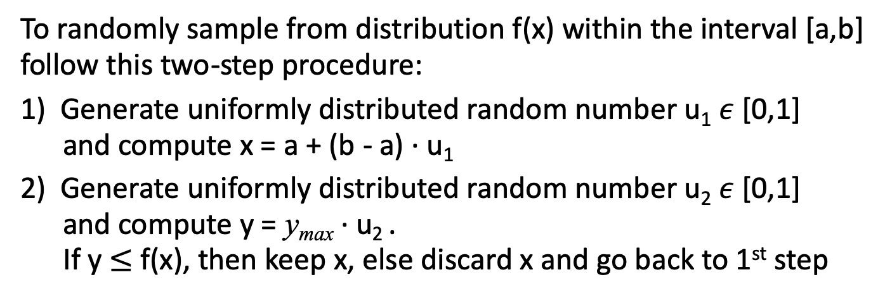
Rejection Sampling
To randomly sample from distribution f(x) within the interval [a,b]
follow this two-step procedure:
1) Generate uniformly distributed random number u₁ $ε$ [0,1]
and compute x = a + (b - a) ∙ u₁
2) Generate uniformly distributed random number u₂ $ε$ [0,1]
and compute y = y_{max} ∙ u₂ .
If y $≤$ f(x), then keep x, else discard x and go back to 1st step
denotes the maximum of the distribution
f(x) within the interval [a,b]
The 2nd step ensures that the probability to obtain a random number with value x is is equal to f(x)
https://en.wikipedia.org/wiki/Rejection_sampling
https://www.youtube.com/watch?v=kYWHfgkRc9s
Christian Veelken Statistical Methods: Random Numbers 8

Slide 9
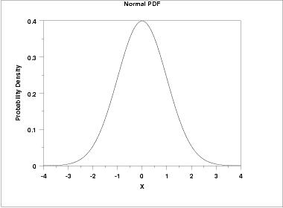
Rejection Sampling
y_{max}
Probability to discard u₁
Probability to keep u₁
u₁ = 0.3125
N.B.: In case the distribution f(x) has a narrow peak, generating random numbers with rejecting sampling becomes time-consuming, as many random numbers will be discarded in the 2nd step of the procedure
Christian Veelken Statistical Methods: Random Numbers 9

Slide 10
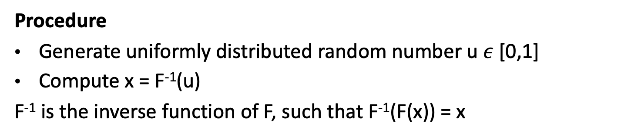
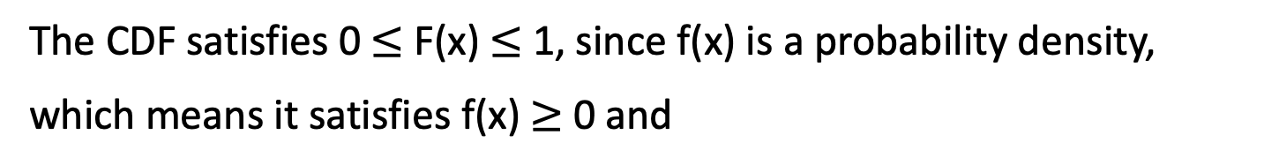
Inverse Transform Sampling
The procedure is based on the cumulative distribution function (CDF)
The CDF satisfies 0 $≤$ F(x) $≤$ 1, since f(x) is a probability density,
which means it satisfies f(x) $≥$ 0 and
Procedure
Generate uniformly distributed random number u $ε$ [0,1]
Compute x = F⁻¹(u)
F⁻¹ is the inverse function of F, such that F⁻¹(F(x)) = x
https://en.wikipedia.org/wiki/Inverse_transform_sampling
https://www.youtube.com/watch?v=rnBbYsysPaU
Christian Veelken Statistical Methods: Random Numbers 10

Slide 11
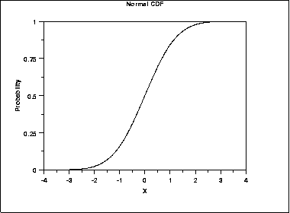
Inverse Transform Sampling
u = 0.3125
x = -0.5
Christian Veelken Statistical Methods: Random Numbers 11

Slide 12
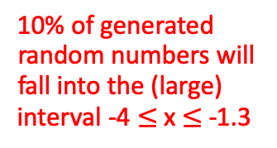
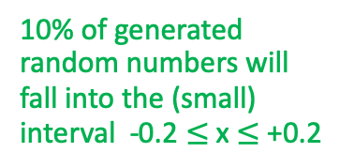
Inverse Transform Sampling
Interpretation
The CDF rises rapidly in the region of x where the PDF peaks
Most of the points will be sampled from the region around the peak
Let’s assume we divide the area below the PDF into 10 regions of equal size:
The interval covered by each region on the x-axis is then inversely proportional to f(x)
Since we generate the same amount of random numbers in each region, the density of points on the x-axis is inversely proportional to the length of the interval, thus proportional to f(x)!
10% of generated random numbers will fall into the (small) interval -0.2 $≤$x $≤$ +0.2
10% of generated random numbers will fall into the (large) interval -4 $≤$x $≤$ -1.3
Christian Veelken Statistical Methods: Random Numbers 12

Slide 13
Inverse Transform Sampling
The method is more useful in practice than one might think at first:
The CDF of any distribution f(x) can be obtained by numeric integration
The inverse function F⁻¹ can be obtained in practice by making a graph of F(x) and swapping x- and y-axis
for some large N
Christian Veelken Statistical Methods: Random Numbers 13

Slide 14
Special Cases
Random angles (points on a unit sphere)
Gaussian distribution (with mean $μ$ = 0 and width σ = 1)
holds approximately (not exactly)
based on Central Limit theorem
Christian Veelken Statistical Methods: Random Numbers 14

Slide 15
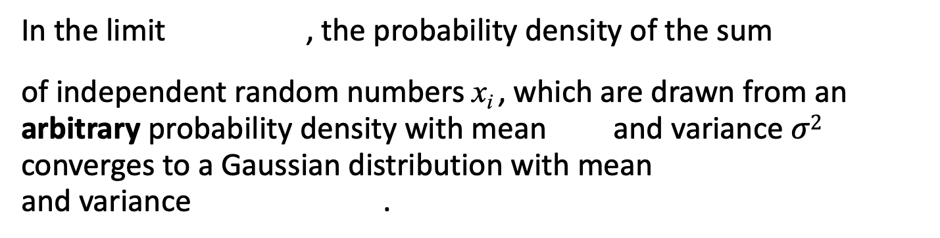
Central Limit Theorem
In the limit , the probability density of the sum
of independent random numbers x_{i} , which are drawn from an arbitrary probability density with mean and variance $σ2$ converges to a Gaussian distribution with mean and variance .
A generalized version of the theorem covers the case that the random numbers x_{i} are drawn from distributions that are different for each x_{i} .
Note: The Central Limit theorem is strictly valid only for the core of the distribution (not for the tails) and only in the case that each distribution from which the random numbers x_{i} are drawn has a finite variance (this is not always the case!)
The Central Limit theorem is the reason for the special importance of the Gaussian distribution in statistics
Christian Veelken Statistical Methods: Random Numbers 15

Slide 16
Exercise
Write some code (in C++ or python) that demonstrates the use of
random sampling
inverse transform sampling
for a Gaussian distribution with mean = 91.2 GeV
and width = 4.5 GeV
https://root.cern.ch/root/html524/TMath.html#TMath:Gaus
Plot the distributions using histograms with 30 bins in the range between 60 and 120 GeV and compare with the histogram that is expected in the limit of infinite event statistics:
TH1::GetXaxis()->GetBinUpEdge()
TH1::GetXaxis()->GetBinLowEdge()
Gaussian Error function
https://root.cern.ch/root/html524/TMath.html#TMath:Erf
Christian Veelken Statistical Methods: Random Numbers 16

Slide 17
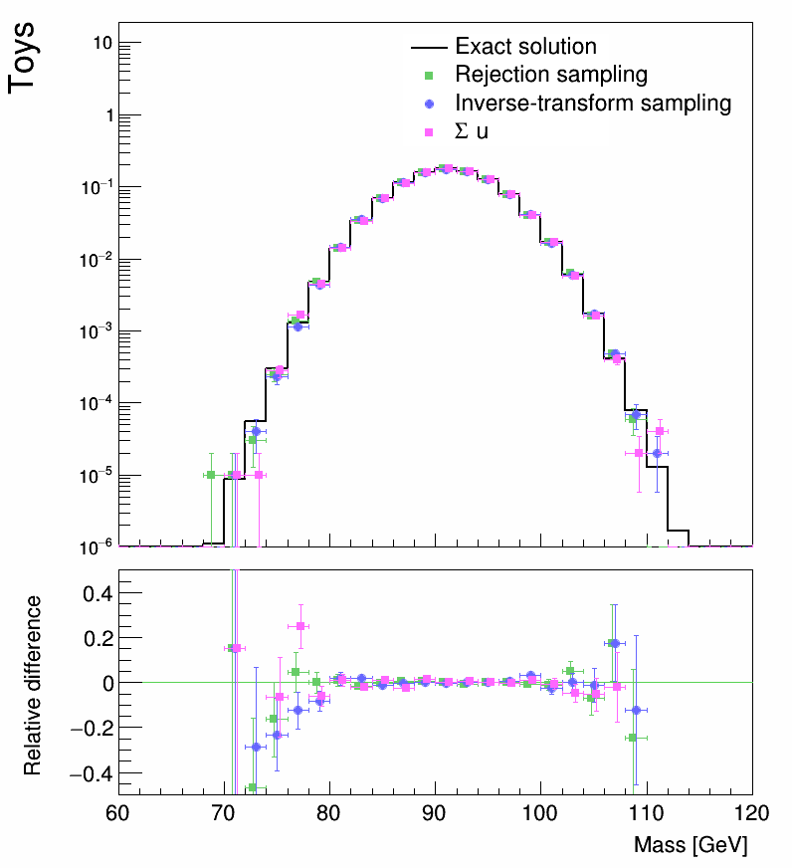
Exercise
The result of the exercise should look similar to this plot:
N.B.: The coordinates of the points on the x-axis are each shifted by a different (small) amount, so that one can better see the error bars. You can find code for making the plot in the style shown on this slide on quasar, at the location
/home/veelken/public/PhyStat-101/rndNumGen_showHistograms.C
Christian Veelken Statistical Methods: Random Numbers 17

